Slide 1
SCM 651: Business Analytics
Week 7

Slide 2
Agenda
Overview of homework #3 (Regression and Optimization)
Review of hands-on exercises
Group discussion of articles
Big Data in Health Care: Using Analytics to Identify and Manage High-Risk and High-Cost Patients
A Review of Analytics and Clinical Informatics in Health Care

Slide 3
Homework #3
Graph, regression, calculated sales, revenue, profit
Constrained optimization
Discussion of risks, other data which would be valuable

Slide 4
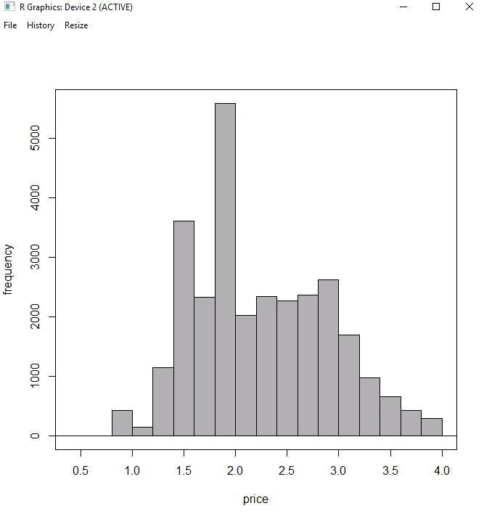
Week 7 - Review
Histograms display the frequency of data within an interval, often called a bin

Slide 5
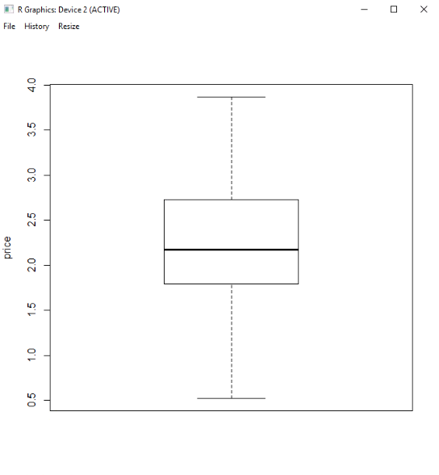
Week 7 - Review
Box plots show the quartiles of data
Interquartile range (IQR) (third quartile minus first quartile)
Outliers: data points more than 1.5 times IQR above the third quartile or below the first quartile

Slide 6
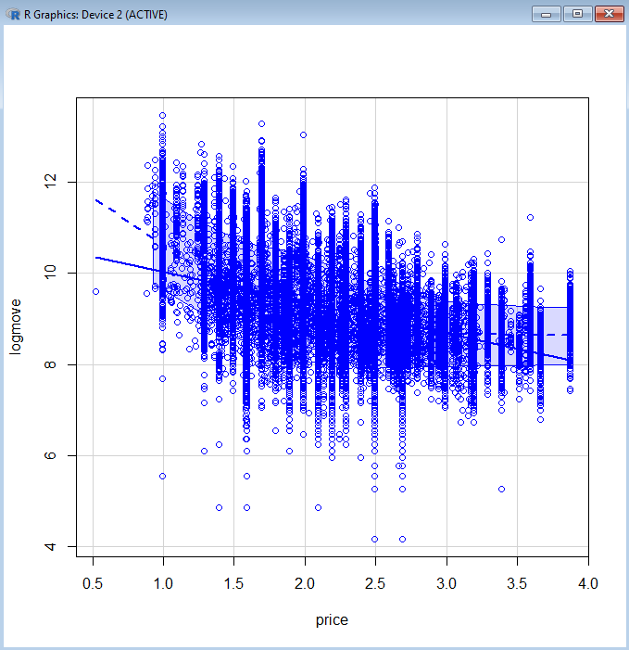
Week 7 - Review
Scatter plots display the data points on an X and Y axis, with only one X variable and one Y variable

Slide 7
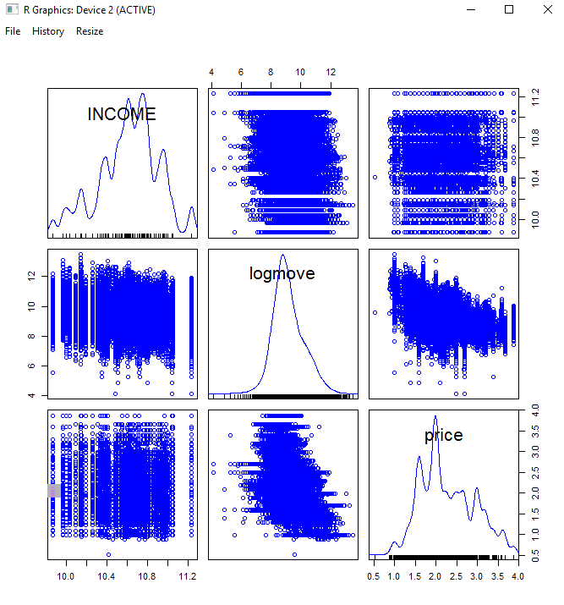
Week 7 - Review
Scatter plot matrix shows data points on multiple scatter plots simultaneously, with multiple X and Y variables

Slide 8
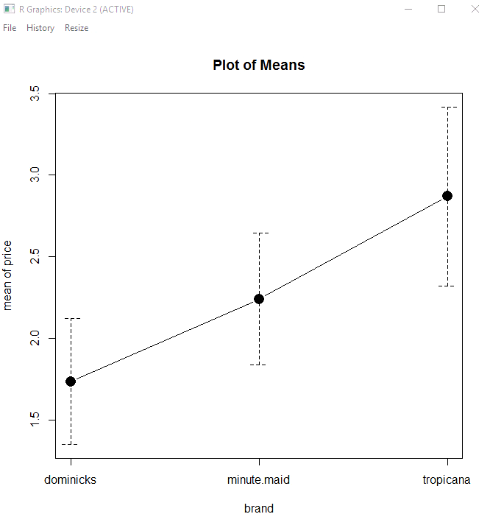
Week 7 - Review
Mean plots display the averages of multiple groups

Slide 9
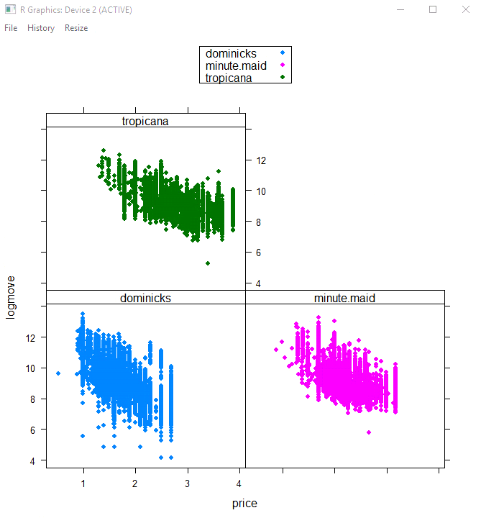
Week 7 - Review
XY plots show scatter plots with different groups in each scatter plot

Slide 10
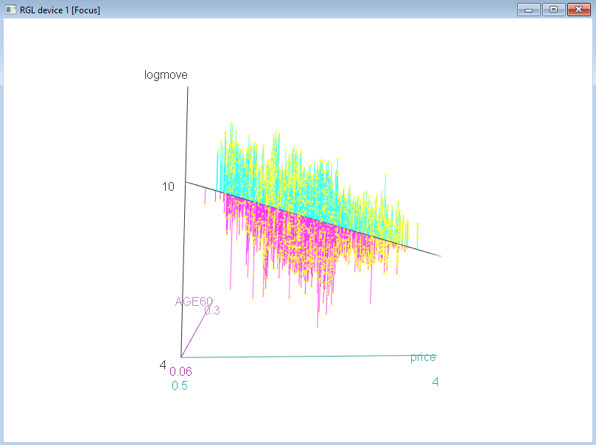
Week 7 - Review
3-D graphs display data in three dimensions with the ability to rotate the graph.

Slide 11
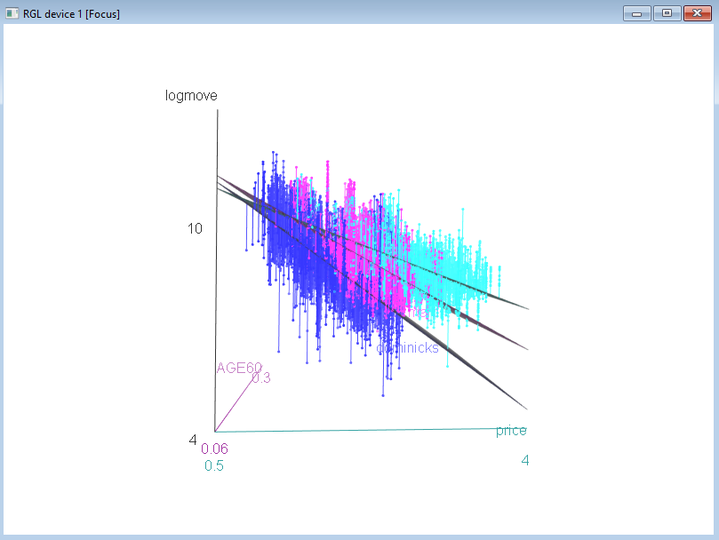
Week 7 - Review
3-D graphs can plot data by groups to identify differences among groups.

Slide 12
Week 7 - Review
R generates descriptive statistics including:
Mean
Standard deviation
Interquartile range
Quartiles
Descriptive statistics can be calculated for an entire dataset or by groups

Slide 13
Week 7 - Review
Correlations measure the direction of relationship between two variables and the strength of the relationship.
Correlation ranges from –1 to +1.
Positive correlation means the variables move in the same direction.
Negative correlation means the variables move in different directions.
Correlations close to 0 are weak; far from 0 are strong.

Slide 14
Week 7 - Review
Analysis of variance (ANOVA) examines groups and determines if the mean (average) of one group is different from the others.
Pairwise ANOVA identifies which group average is different from the others.

Slide 15
Week 7 - Review
Regression determines the relationship between one or more X-variables and one Y-variable, measuring the direction and magnitude of change of Y when X changes
In the example of income as the Y (dependent variable) and X (independent variable), the equation would be:
Income = β₀ + β₁ * Education
+
Education
Income

Slide 16
Week 7 - Review
Consider a third variable, technology, that magnifies or reduces the effect of education on income (interaction)
In this example, the equation would be:
Income = β₀ + β₁ * Education + β₂ * Education * Technology
+
Education
Income
+
Technology

Slide 17
Week 7 - Review
Dummy variables allow one to change the intercepts in a regression for different groups.
The number of dummy variables required is one less than the number of groups, e.g., if examining the demand curves for three types of orange juice, then two dummy variables are required.

Slide 18
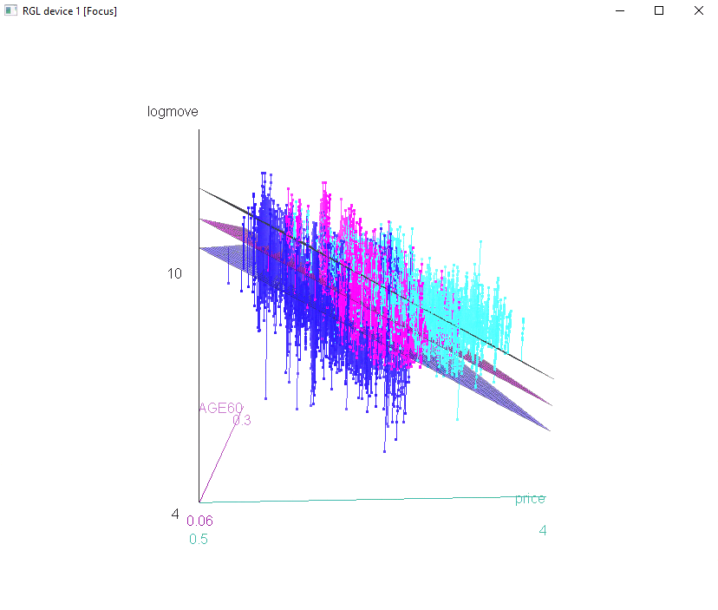
Week 7 - Review
Demand curves with three types of orange juice.
Dummy variables create different intercepts.
The difference between the lines represent brand premium.

Slide 19
Week 7 - Review
Moderating effects change the slopes in a regression for different groups.
Moderating effects, also called interaction terms, are created by multiplying together two variables.

Slide 20
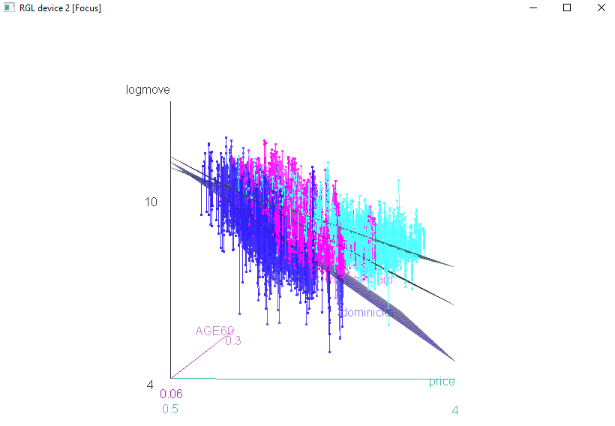
Week 7 - Review
Demand curves with three types of orange juice.
Moderating effects change the slope for each brand of orange juice.
The different slopes represent different elasticities of demand.

Slide 21

What's a pirate's favorite programming language?
R

Slide 22
What did the Box Plot say to the outlier?
"Don't you dare get close to my whisker!!"

Slide 23

Alcoholic Statistician
What is an alcoholic statistician’s favorite graph?
Box – and – whiskey chart

Slide 24
Article #1: Big Data in Health Care
Big Data in Health Care: Using Analytics to Identify and Manage High-Risk and High-Cost Patients
What are the six opportunities to reduce costs through analytics?
How can cost be reduced in each

Slide 25
Article #1: Big Data in Health Care
Big Data in Health Care: Using Analytics to Identify and Manage High-Risk and High-Cost Patients
What are the six opportunities to reduce costs through analytics?
High cost patients
Readmissions
Triage
Decompensation
Adverse events
Diseases affecting multiple organs
How can cost be reduced in each

Slide 26
Article #2: A Review of Analytics in Clinical Informatics in Health Care
A Review of Analytics and Clinical Informatics in Health Care
What are some methods for improvement in health care using analytics (page 2)
What are some challenges for analytics in health care (page 4)

Slide 27
Article #2: A Review of Analytics in Clinical Informatics in Health Care
A Review of Analytics and Clinical Informatics in Health Care
What are some methods for improvement in health care using analytics (page 2)
Identify patients of greatest risk: early detection in neo-natal care
Wearable monitors: disease prevention though monitoring
Costs savings and resolution of billing anomalies: revenue leakage
Better manage resource allocation: patient’s length of stay
What are some challenges for analytics in health care (page 4)
Garbage in, garbage out
Increased demand for professionals well versed in analytics and medicine

